Slide 1
Integer Programming -Facility location problem
California Manufacturing Co.
Considers building new factory in Los Angeles or San Francisco, or both
Considers building at most one new warehouse
Choice of location restricted to city where factory is being built
Objective: find the feasible combination of alternatives that maximizes the net present value

Slide 2
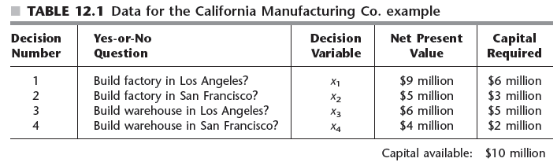
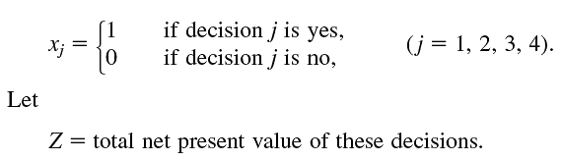
Integer Programming -Facility location problem

Slide 3
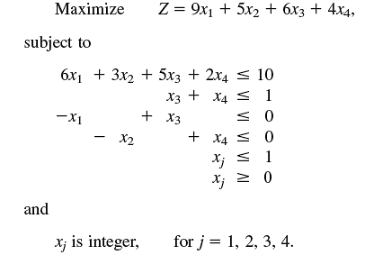
Integer Programming -Facility location problem

